Slide 1
Coffee Shops in Toronto
Where should our client put his new shop?

Slide 2
Location is a key consideration for any new business
There are already a lot of coffee shops in Toronto.
Our client wants to put his shop in a location where there is enough demand for his product but not so much competition that he will be unable to enter the market.
We will look at locational market saturation to determine which areas like coffee but would still support a new shop.

Slide 3
Data used
Toronto Wikipedia page – can be found at 'https://en.wikipedia.org/wiki/List_of_postal_codes_of_Canada:_M’
Foursquare API information. I have narrowed the dataset to only include records that have “coffee shop” as the venue.
After cleaning a few missing records and reshaping the data, the final dataset consists of 173 records and 7 features.

Slide 4
Foursquare API locational data
The preliminary search through Foursquare by neighborhood area returned 2,136 venue records. These venues ranged from Portuguese restaurants to hockey arenas.
Our entrepreneur client is only interested in venues that sell coffee as their primary product, so I eliminated all of the records except those with the category “coffee shop.”
This returned a dataset of 173 records.

Slide 5
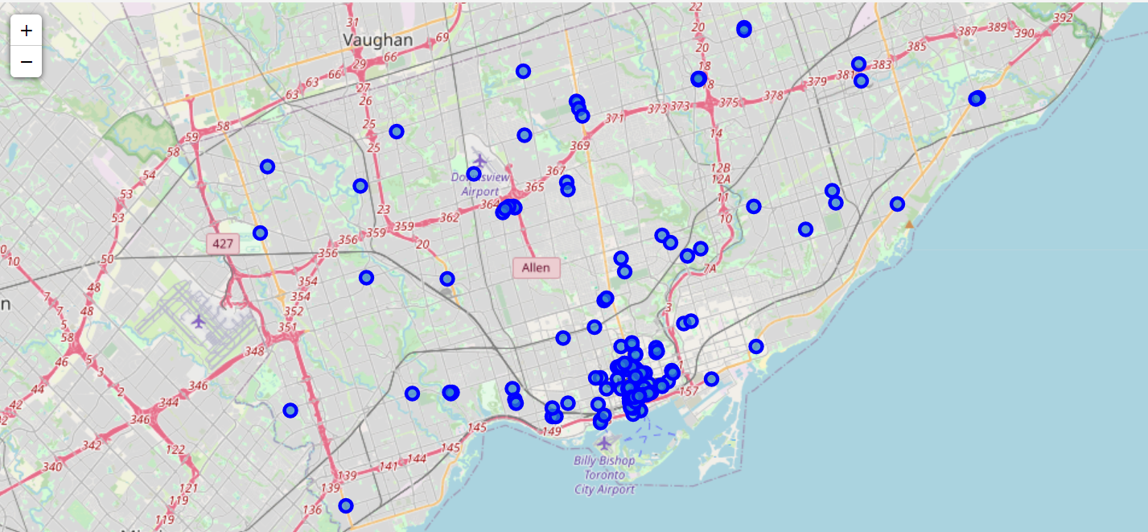
Map of existing shops

Slide 6
Map observations
The map shows a high concentration of coffee shops in the areas near the Billy Bishop City Airport.
This is a good indicator of higher population density in these areas.
Our client wants an area with middle-of-the-road density. This will provide a more affordable facility rent price while still providing the necessary traffic.

Slide 7
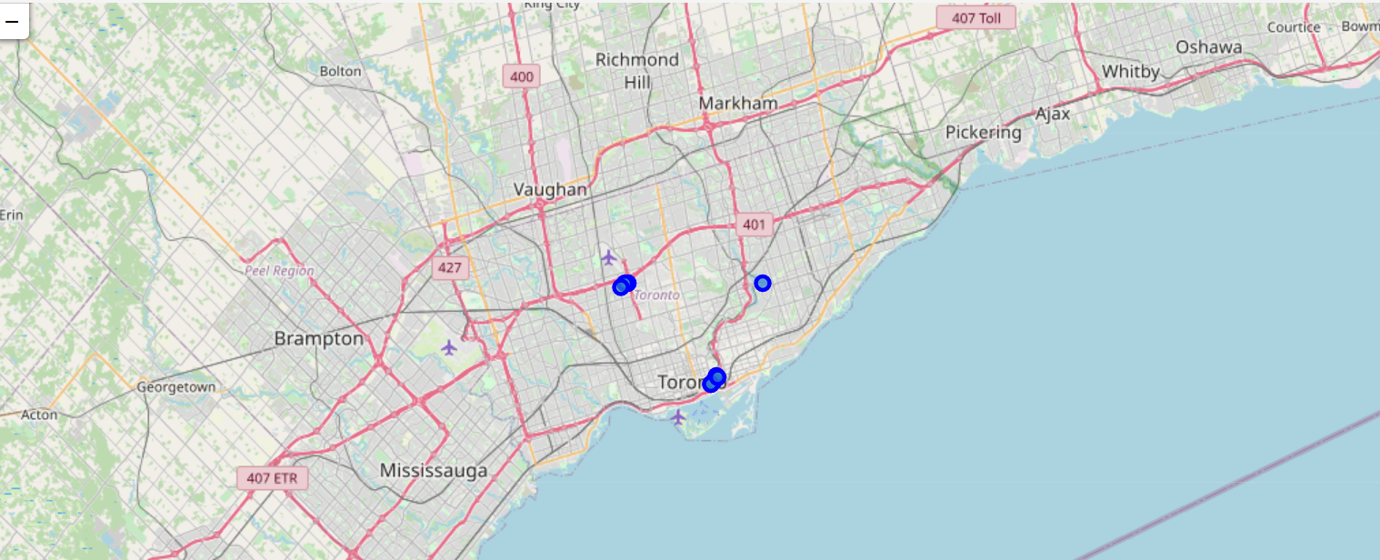
Areas with lower density – but not too low

Slide 8
Addition Considerations
In a typical business scenario, other factors should be included in location analysis, such as:
Per capita income of area
Crime levels
Proximity to mass transit
Population density
But this information will give our client a starting point for further analysis.

